Slide 1

HERE BE DRAGONS
EXPLORE, ADVENTURE, DISCOVER

Slide 2
UNIQUE SELLING POINTS
A top down 2d exploration game
Pixel art aesthetic
Emergent game play
Create your own character
Unique combat features
Randomly generated environment and enemy units

Slide 3

MARKET DATA
TARGET AUDIENCE
USER STORY
Casual
Indie
Adventure and exploration
14 to 30+ years of age
TARGET REGION
America
Canada
Europe
UK

Slide 4
MARKET DATA
SIMILAR GAMES ON THE MARKET
HYPER LIGHT DRIFTER
ELYSIS
LEGEND OF THE SKY FISH
ZELDA ‘THE BREADTH OF THE WILD’

Slide 5
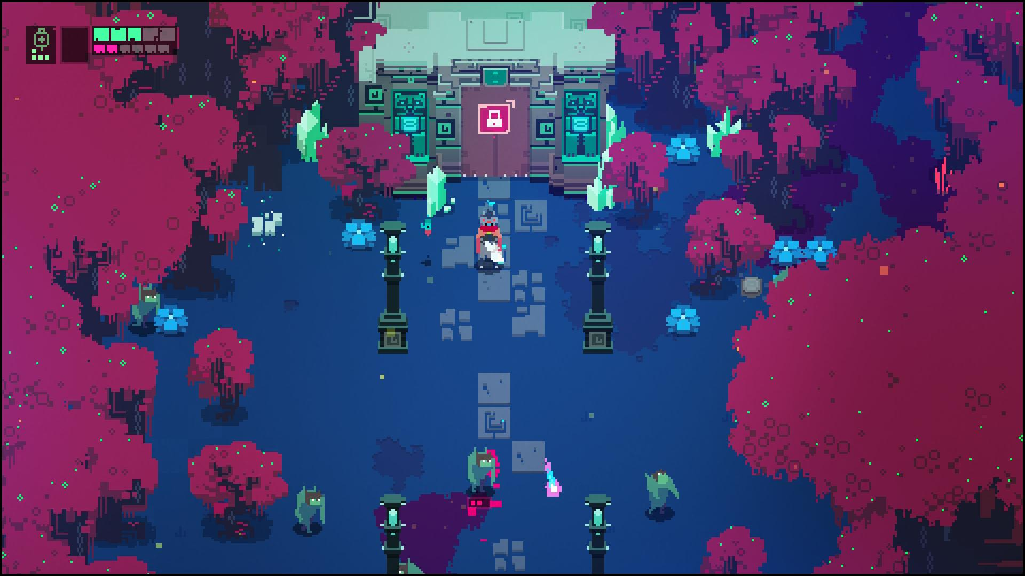
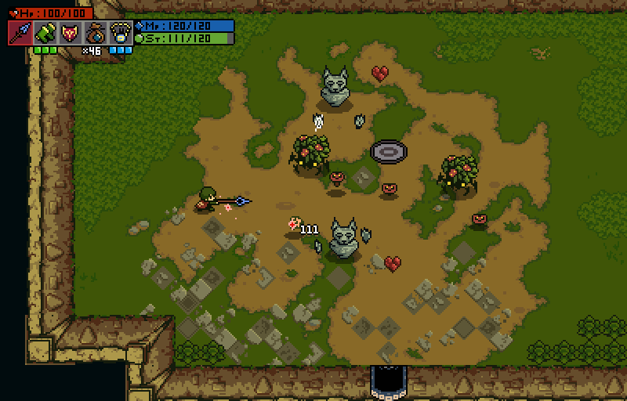
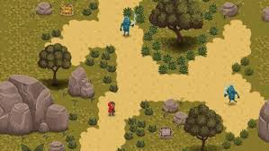
MARKET DATA
SIMILAR AESTHETIC
Hyper light drifter
ELYSIS
Legend of the skyfish

Slide 6
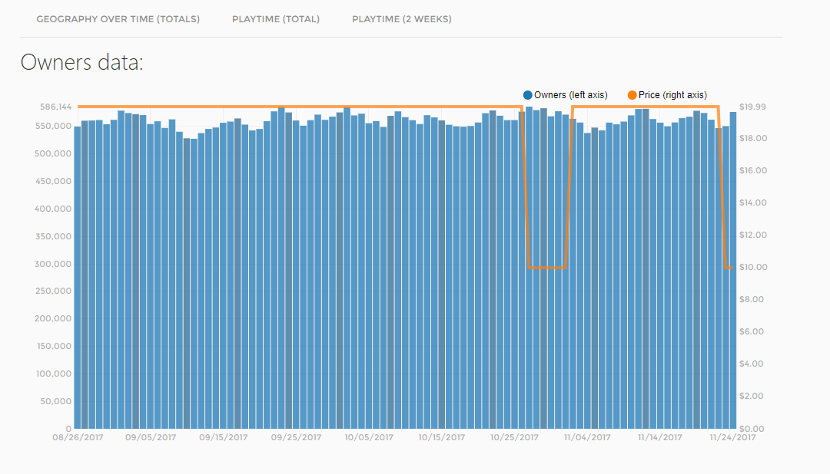
COMPETITOR’S PRICE AND NUMBER OF COPIES PURCHASED ON STEAM
HYPER LIGHT DRIFTER

Slide 7
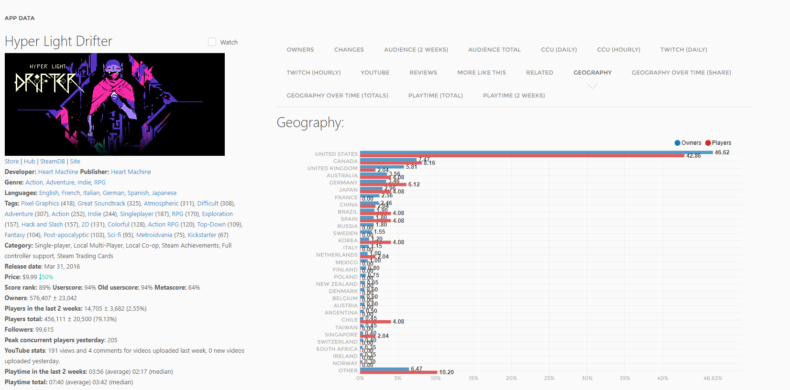
MARKET DATA

